Slide 1

STUDENT RESOURCE AND INFORMATION SYSTEM
Nepal Engineering College, Changunaran, Bhaktapur
Project Memebers:
Arjan KC
Ashok Ghimire
Marshal Babu Basnet
April 2013

Slide 2
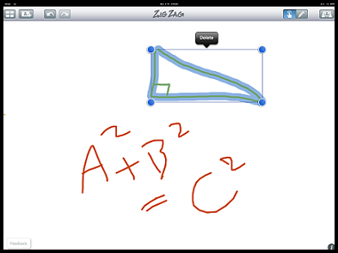
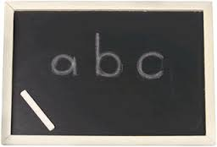
Background and Statement of problem
Primitive duster/chalk technology
Digital whiteboard technology

Slide 3
Objective and scope
To share idea in efficient manner.
To make classroom time interactive and valuable.
To minimize distance between the class and outer reality by taking visual thinking in effect.
To manage the resources needed to the students.
To keep information regarding the students’ academic progresses.
To implement cloud based web app that is accessible to the students and teachers alike anywhere in the world.

Slide 4
Application
In universities for advanced teaching methodology.
In business for sharing ideas among staffs.
And in any field where ideas has to be shared like presentations, seminars, expos etcetera.

Slide 5
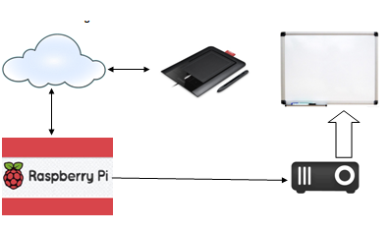
Block Diagram

Slide 6
Methodology and Design requirement
Web designing with management of resources and information of students.
Most importantly we will need a working knowledge of database systems such as mySQL as we will be working a lot on databases.
Use of latest web designing tools and languages such as HTML 5, CSS 3, jquery, ajax and other scripts.
Interfacing devices to create a projection unit capable of connectivity, like a projector with raspberry pi.
Instructor can enter input to the whiteboard through his/her smart phone or other digital ink enabled device.

Slide 7
Feasibility Study
White board web app rather than making digital board display which is costly to implement.
$35 computer (raspberry pi) in place of conventional laptop for connectivity and affordability.

Slide 8
Testing Plan
Our application will be tested on the go as per the application development goes on.
Later, on the beta testing stage we will require few student volunteers and teacher too for product testing and user experience rating. After which we will reconsider modifying our project as per the results of the tests.

Slide 9
Expected Output
We intend to revolutionize the teaching/learning process in the classrooms by implementing a digital and interactive whiteboard system which is affordable and easily accessible.

Slide 10
Student Resource and Information System
Please follow us on our blog for further information and recent happenings about our project.
http://sris3106.tumblr.com/
Thank You!

